Slide 1
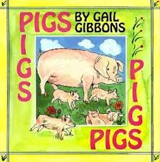
Pigs
By Gail Gibbons

Slide 2
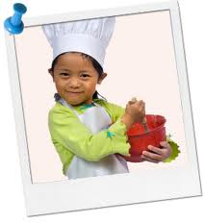
Characteristics
The way something or someone looks, sounds, tastes, feels, or smells
White Hat
Girl
Red Bowl

Slide 3

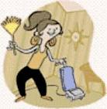
Tidy
Nice and neat

Slide 4
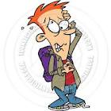
Distressed
To be scared, worried or in pain

Slide 5
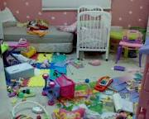
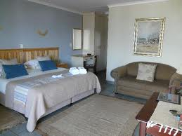
Which one goes with tidy?

Slide 6

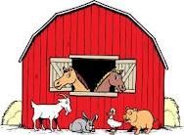
Which one goes with Characteristics?
Red barn
White goat

Slide 7

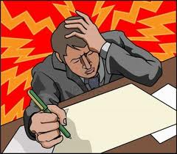
Which one goes with distressed?

Slide 8
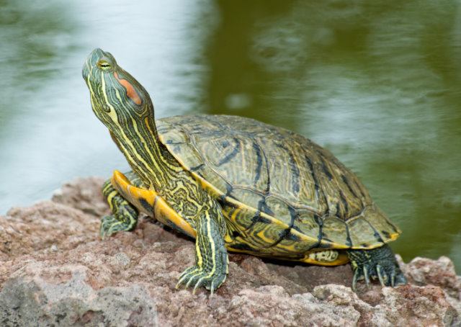
Which word goes with this picture?
Characteristics, tidy, distressed ?
Water
Hard Shell
Rock

Slide 9
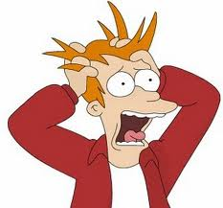
Which word goes with this picture?
Characteristics, tidy, distressed?

Slide 10

Which word goes with this picture?
Characteristics, tidy, distressed?

